Slide 1
What Drives Delayed Diabetes Follow-Up?
Designing Better Care Pathways to Reduce Diabetes Follow-Up Delays.
Team: Fourcast
Notes:
Hi everyone, we are team Fourcast, and today we will dive into one of the most critical challenge of diabetes - consistent management. So, what drives delayed diabetes follow-up?

Slide 2
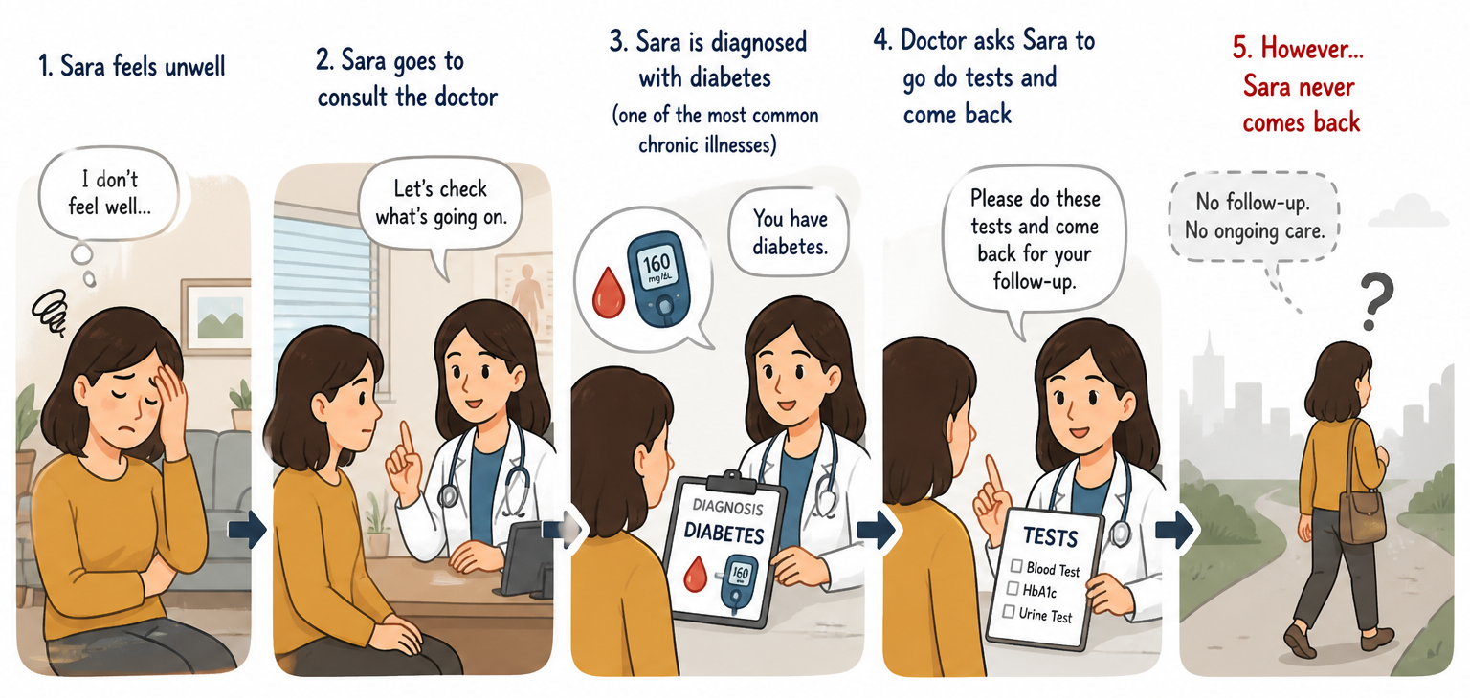
Introduction: The Problem
Notes:
First of all, let’s look at our character Sara. Sara is a resident of a rural community in Kansas. One day, Sara felt unwell and went to the doctor. The doctor told her that she has Type 2 diabetes and needs to do some testing and come back for follow-up. However, Sara never came back.

Slide 3
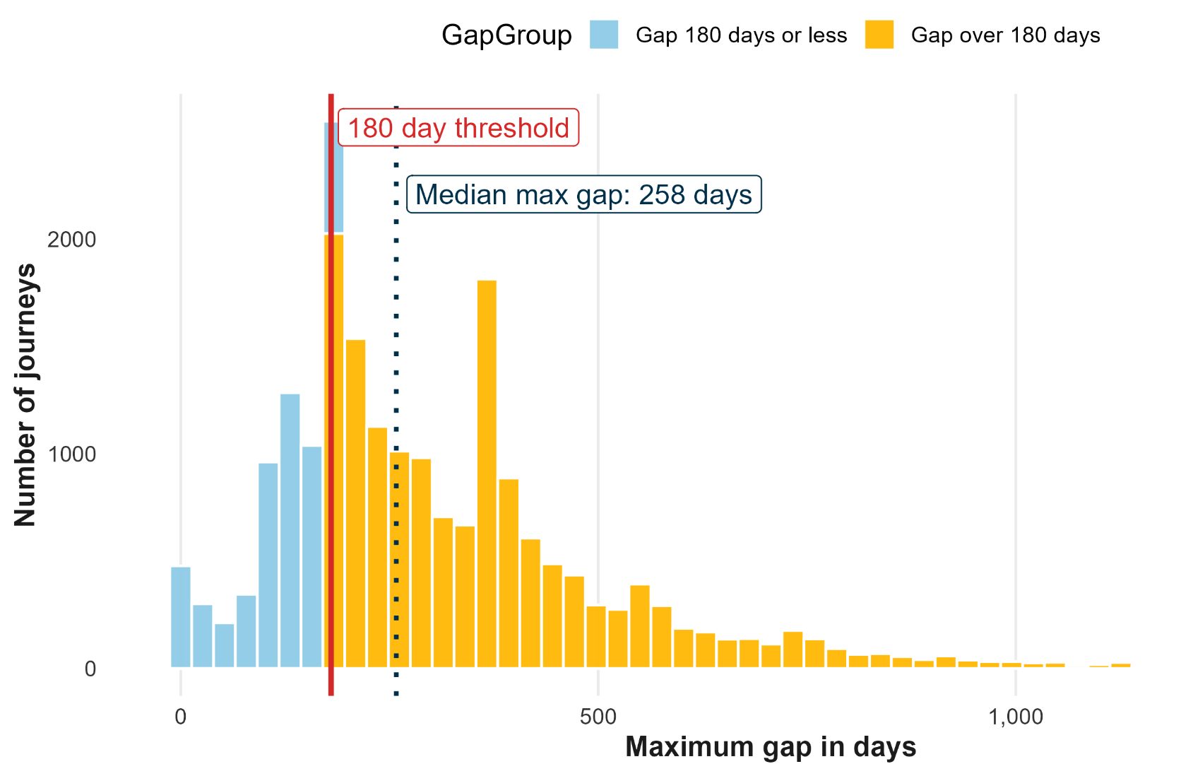
Our Focus: Why Type 2 Diabetes?
Most Type 2 Diabetes Journeys have long follow up gaps:
Ideally, patients should have check-up every 3~6 months. This goes much longer for SVH’s patients.
Notes:
Actually, there are many people like Sara in Kansas. Type 2 diabetes is one of the top, fastest-growing, and most costly chronic conditions. Diabetes requires ongoing, lifetime management, and patients who miss appointments had 60% greater odds of rehospitalization compared to those follow the schedule. While the ideal follow-up date for a doctor’s visit is typically every 3 to 6 months, the SVH’s data shows that a typical diabetes patient has a follow-up day of 258 days. This led to our question - what caused this significant delay?

Slide 4
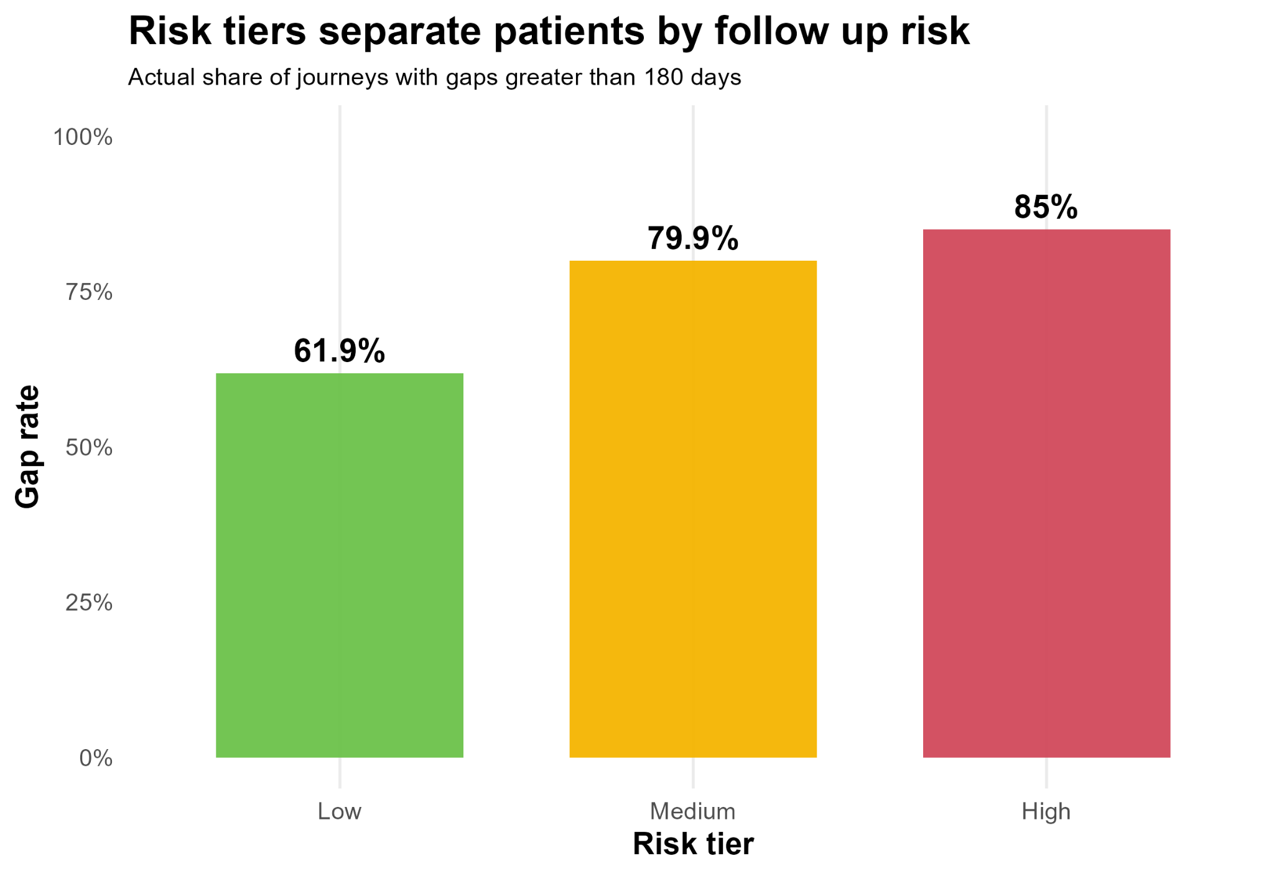
Model: Who Will Miss Follow-Up?
A Random Forest Model used to categorize patients into 3 risk groups:
High-risk patients are ~20% more likely to have long follow-up delay vs. low-risk patients.
Notes:
To turn this into something insight, we built a random forest model. The goal was to predict which Type 2 diabetes patients are more likely to go over 180 days without another diabetes related encounter. We only included patients with at least 365 days of observation time and removed first encounter year because that mostly reflected the data window rather than real patient risk. The model then placed patients into low, medium, and high risk tiers. After building the risk tiers, the next question was: what information helped the model separate low risk from high risk patients?

Slide 5
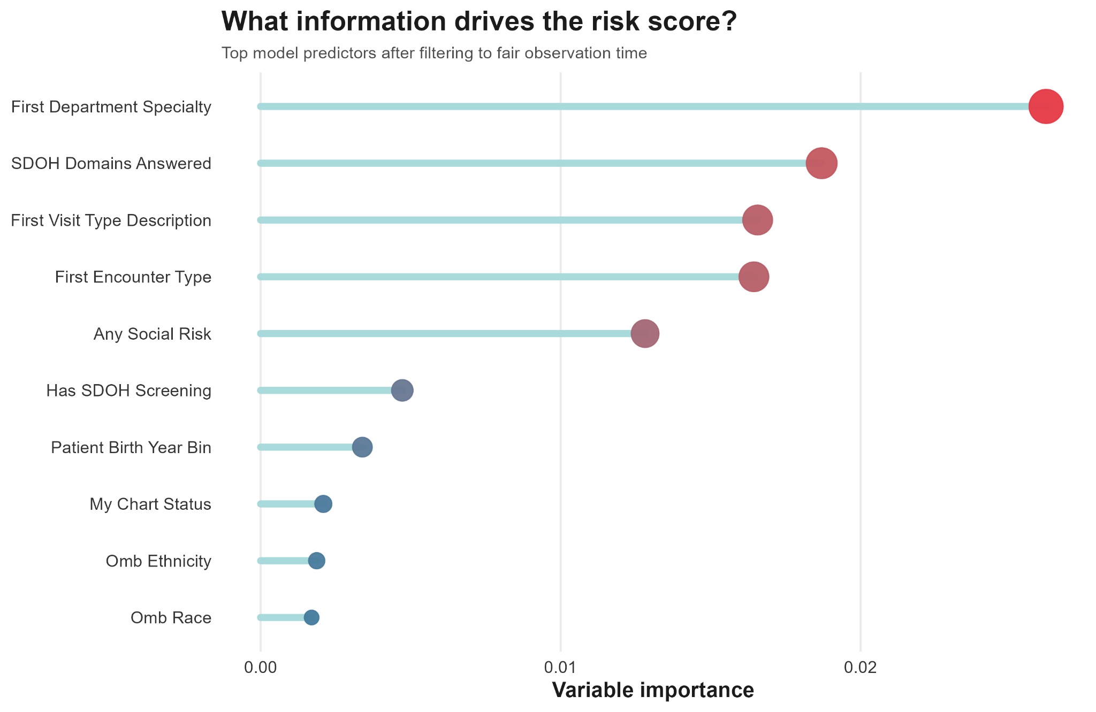
Predictors: What Affects Follow-up Delay?
Top Predictors of Follow-Up Gaps:
From these significant predictors, we focuses on First Encounter Type, MyChart Status, and Any Social Risk as the key actionable drivers for improving patient follow-up gaps.
Notes:
From our model, we found the following predictors had the most importance in determining which risk group someone should be placed into. For example, the predictor with the most importance was First Department Specialty, which tells us what department the institution the patient first visited on their journey specialized in. However, this isn’t something that SVH could change, so we did not include these types of predictors in our final analysis. Instead, we chose to look at some variables that could be changed and that do have a meaningful impact based on our model, with those predictors being First Encounter Type, MyChart Status, and Any Social Risk.

Slide 6
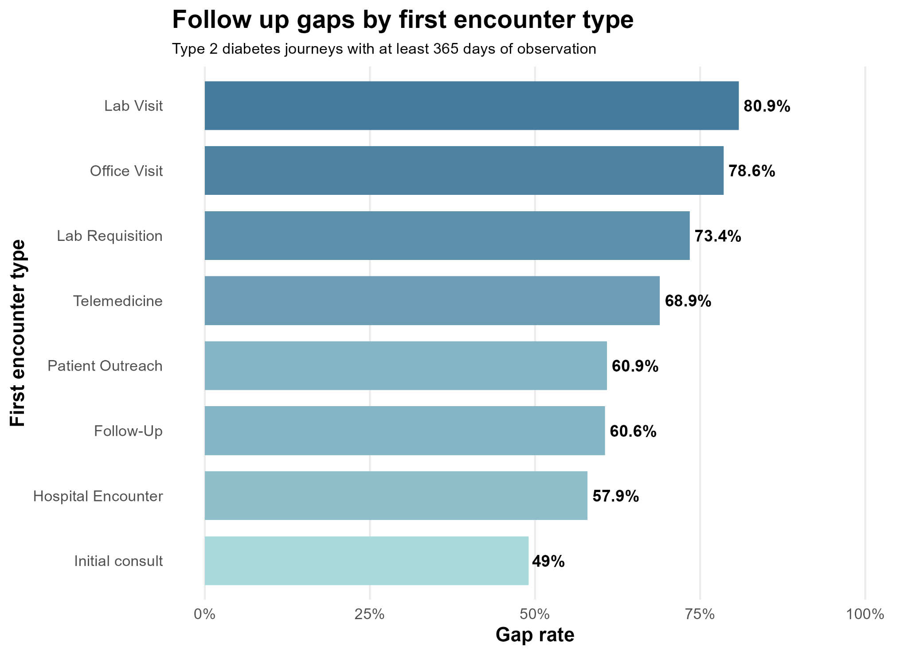
First Encounter Type
Lab and Office Visits Lead to the Highest Follow-Up Gaps (>78%) :
Among all types, lab and office visits carry the greatest risk of patients not returning for timely follow-up.
Notes:
This graph shows the types of encounters patients first have when starting their journeys, and it lists them based on how likely they are to have a gap of over 180 days between this encounter and their next one. So, for example, any patient whose first encounter on their journey with type 2 diabetes is a lab visit will have an 80.9% chance of having a gap of over 180 days from their lab visit to their next encounter. From this graph, we can see that lab and office visits lead to the highest chance of having a long gap and thus are the most important aspects to address.

Slide 7
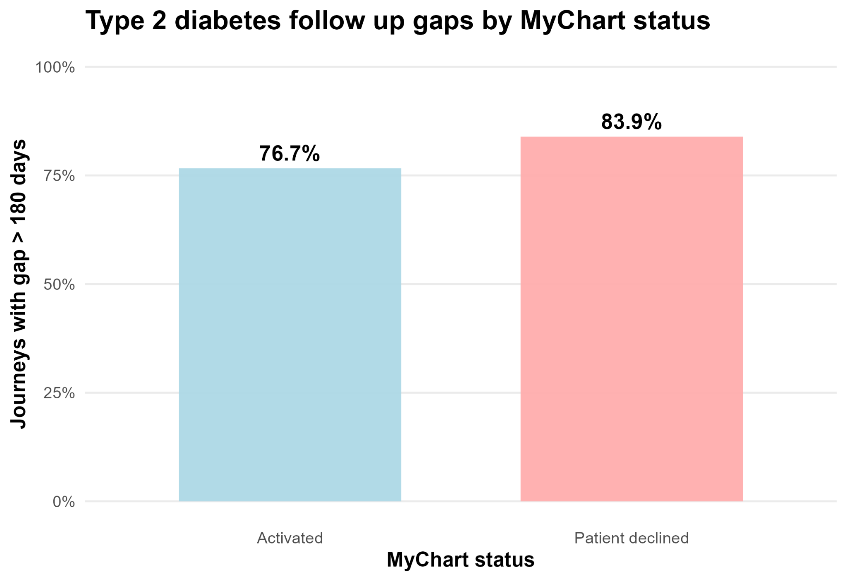
MyChart Status
7.2% Performance Margin:
Patients who use MyChart have a 7.2% lower rate of long follow-up gaps compared.
Notes:
Here we can see the impact of MyChart usage on follow-up gaps between patient visits. MyChart is an online patient portal that allows patients to access their medical records, communicate with healthcare providers, request prescription refills, and review lab results.
The internal data suggests that use of MyChart is associated with a 7.2% improvement in maintaining timely follow-up schedules, reflecting better coordination between Type 2 diabetes patients and healthcare workers, and fewer missed or delayed appointments. Overall, MyChart is an effective digital health tool that improves patient engagement and supports more consistent care delivery.

Slide 8
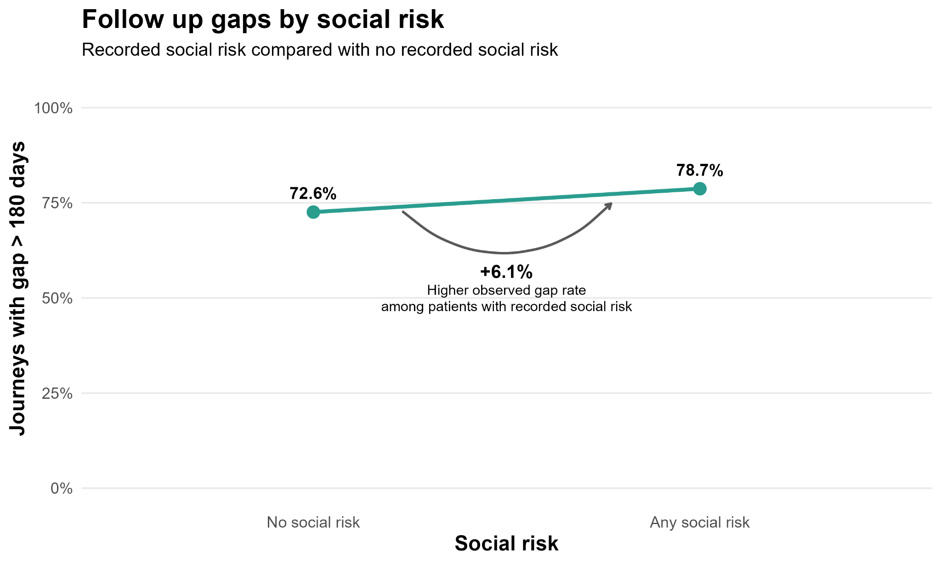
Social risk
6.1% Higher Follow-Up Gaps with Social Risk Factors, which include:
Transportation
Food/Housing Insecurity
Financial Strain
Stress & Depression
Social Isolation
Notes:
We also looked at how social risks impacted the likelihood of a patient having a follow-gap of over 180 days. The factors that determine whether a patient has social risk are difficulty in accessing transportation, food/housing insecurity, financial strain, stress, depression, and social isolation. If a patient responded as having any of the social risk factors, then they were considered to be part of the “Any social risk” group. Based on the data, we see that having a social risk means having a 6.1% higher chance of having a long follow-up gap.

Slide 9
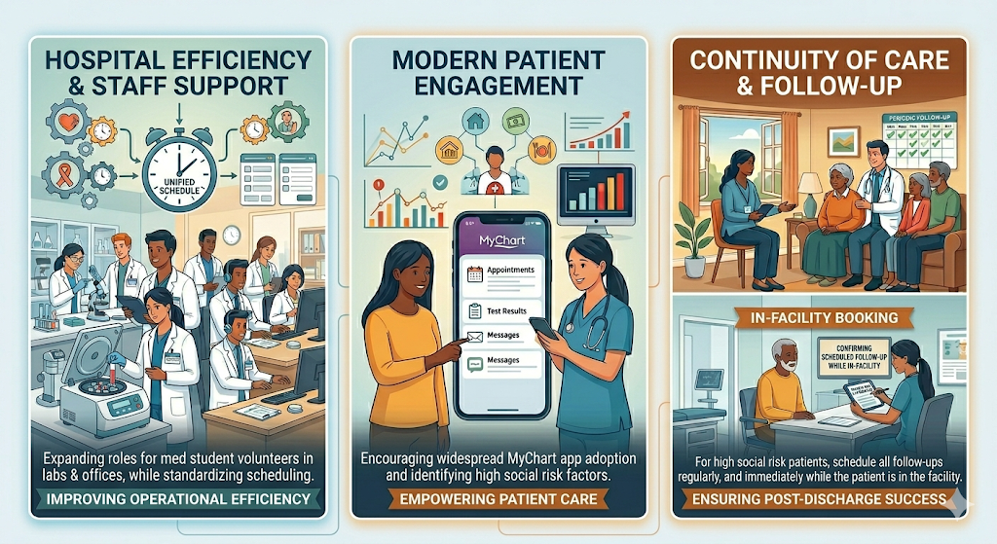
Suggestions
Notes:
After analyzing all of our data, we arrived at some conclusions that we believe Stormont Vail Health could implement that wouild help patients with type 2 diabetes get the care they require. Firstly, we believe that getting volunteer/medical students to help in the labs and offices would help reduce the follow-up time for patients by processing results faster and to aid with scheduling. Furthermore, scheduling could be standardized across departments to make a potentially complex system more manageable and easier to use. Secondly, we found that patients with MyChart were more likely to have appropriate follow-up times than those who opted out, so we think they could push for more patients to get the app. Thirdly, we saw that those with any social risk had a higher likelihood to have a long follow-up gap, so we suggest that they should be followed-up with. Expanding on that, we would advise that anyone that the model predicts to be part of the high risk group should have their follow-up appointments be booked before they finish their encounter. We’d argue only those in the high risk group have their follow-ups booked like this as otherwise it would overload the system. Delayed follow-up isn’t primarily about who the patient is, it’s about how the healthcare system engages them at the start and supports them over time. By improving the system and paying more attention to high-risk individuals, people like Sara will have more consistent management of their illness and enjoy a better life.

Slide 10
Sources
Sun, C. A., Taylor, K., Levin, S., Renda, S. M., & Han, H. R. (2021). Factors associated with missed appointments by adults with type 2 diabetes mellitus: a systematic review. BMJ open diabetes research & care, 9(1), e001819. https://doi.org/10.1136/bmjdrc-2020-001819
Mayo Clinic. (n.d.). Diabetic coma: Symptoms and causes.
https://www.mayoclinic.org/diseases-conditions/diabetic-coma/symptoms-causes/syc-20371475
Centers for Disease Control and Prevention. (2025). Prevalence of diabetes has been increasing (Preventing Chronic Disease, Article 24_0199).
https://www.cdc.gov/pcd/issues/2025/24_0199.htm
Cleveland Clinic. (2023, February 17). Diabetes.
https://my.clevelandclinic.org/health/diseases/7104-diabetes
Notes:
We used these sources for general information on the topic, as well as for specific statistics like the 60% greater chance of rehospitalization for patients with a follow-up gap of over 6 months that came from the fourth source.

